Slide 1
MicroCast: Cooperative Video Streaming on Smartphones
Lorenzo Keller, Anh Le, Blerim Cic, Hulya Seferoglu
LIDS, Christina Fragouli, Athina Markopoulou
MobiSys’12, June 25–29, 2012
Speaker : Chia-Chih,Lin

Slide 2
Outline
Introduction
Related Work
MicroCast Architecture
MicroCast Algorithm
Implementation in Details
Evaluation
Discussion
Conclusion
Comment

Slide 3
Introduction
Motivation
Video traffic increasing(3G and 4G as well)
A group of users want to watch same video within proximity of each other
Problem
Each phone’s individual cellular connection may not be sufficient for providing high video quality

Slide 4
MicroCast System Intro.
MicroCast
MicroDownload
Scheduler
Two interface for data delivery
MicroNC-P2
all-to-all dissemination scheme for local sharing content
Combination of WiFi overhearing and network coding
Significantly outperforms state-of-the-art P2P schemes
MicroBroadcast
High rate packet broadcast(first android-based system)

Slide 5
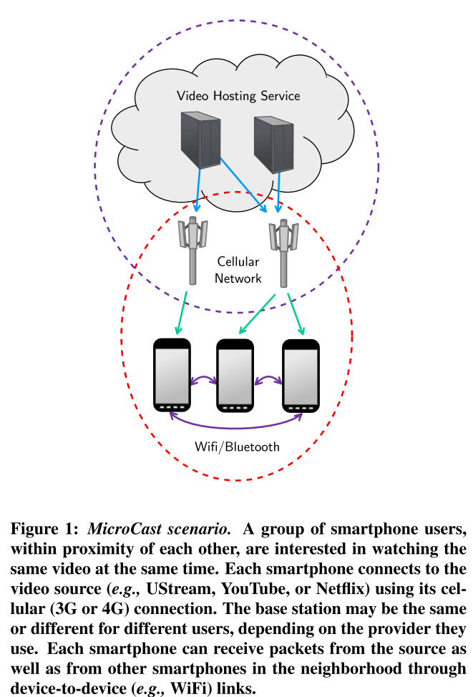
MicroCast System Scenario

Slide 6
Outline
Introduction
Related Work
MicroCast Architecture
MicroCast Algorithm
Implementation in Details
Evaluation
Discussion
Conclusion
Comment

Slide 7
Related Work
Cooperative Mobile/Wireless Systems
WiFi direct in Android(Ice Cream Sandwich)
Network Coding
Cooperative/Wireless Systems
Implementation
Peer-to-Peer system
Optimization
Contribution

Slide 8
Outline
Introduction
Related Work
MicroCast Architecture
MicroCast Algorithm
Implementation in Details
Evaluation
Discussion
Conclusion
Comment

Slide 9
MicroCast Architecture
Setup
3G to server and WiFi to local users
Assumptions
Small number of users(6-7)
Users know and trust each other
All user are within proximity of each other
All local links have similar rates on average
In every phone, cellular connection for the downlink and WiFi to establish local links(parallel)

Slide 10
MicroCast Architecture
MicroDownload
Only runs on one of the phones that initiate download
MicroNC-P2
Distributing segments using local wireless network
MicroBroadcast
Pseudo-broadcast over WiFi
Requester
Retrieves segments of video from the video source
Storage
Graphical User Interface(GUI)
Notes:
MicroDownload : only run on one of phones(in the group) that initiates the download, instructs the requesters of all phones which segments to download from the server

Slide 11
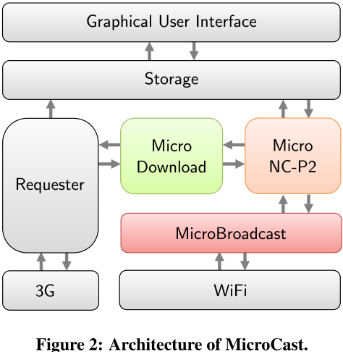
Architecture

Slide 12
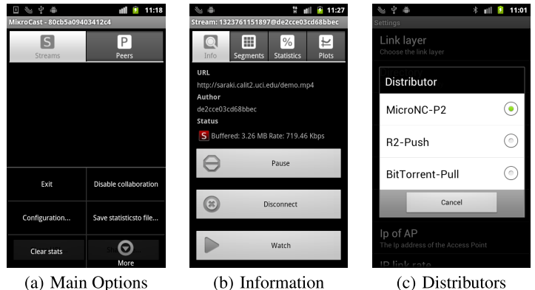
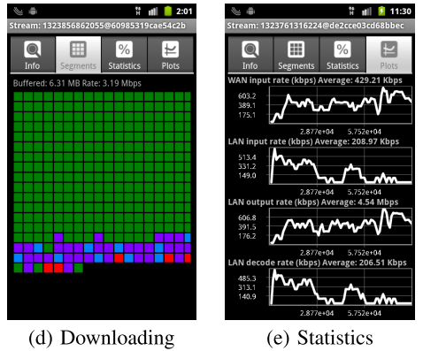
GUI

Slide 13
Outline
Introduction
Related Work
MicroCast Architecture
MicroCast Algorithm
Implementation in Details
Evaluation
Discussion
Conclusion
Comment

Slide 14
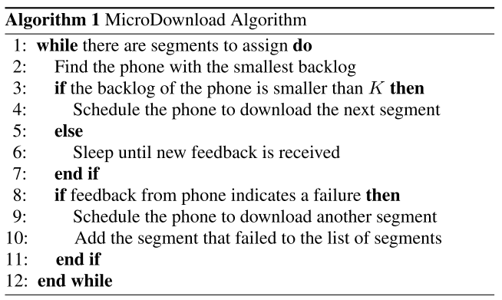
MicroCast Algorithm

Slide 15
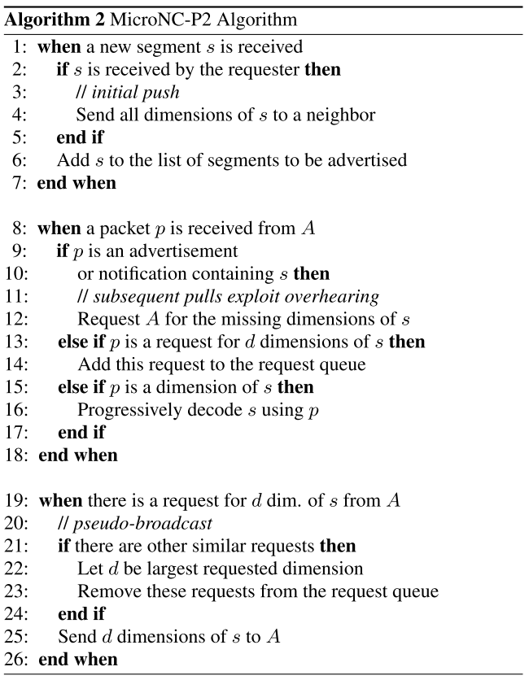
MicroCast Algorithm

Slide 16
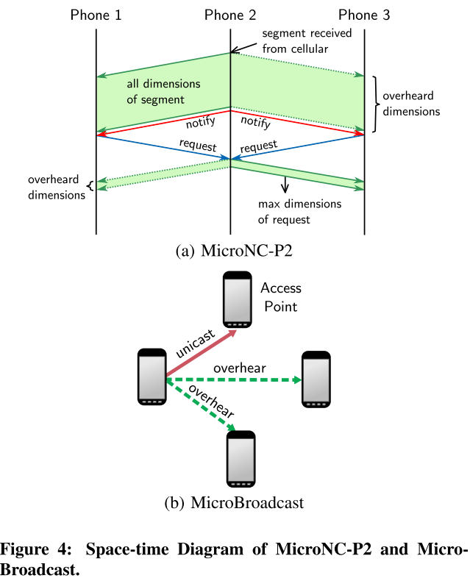
MicroCast Algorithm

Slide 17
Reception Rate
Where Rl is Receive rate in local,Rc is Receive rate in cellular, and N is the number of phones

Slide 18
Outline
Introduction
Related Work
MicroCast Architecture
MicroCast Algorithm
Implementation in Details
Evaluation
Discussion
Conclusion
Comment

Slide 19
Architecture Details
Devices
Requester
Three types of sources: HTTP, file, and content
Storage
Java API,
Android MediaPlayer(for playback)
GUI
MicroBroadcast
Application layer implementation of a network stack
Notes:
HTTP from server
File means local file
Content represents ContentProvider API by android , (e.g., camera)

Slide 20
Multiple Network Interface
Downlink(3G or WiFi)
Local cooperation(WiFi or Bluetooth)
Not suggest WiFi+Bluetooth
Challenges from android connectivity manager
Shut down when both interface are activated

Slide 21
Network Coding
Use generation-based network coding
CPU Limitations
NC is CPU intensive operation
Need an efficient way to encode/decode
Java vs native code (C)

Slide 22
Implementing High-Rate WiFi Broadcast
Disadvantages in 802.11 broadcast mode
Lacks a back-off mechanism
Transmission rate is limited(base rate, 1Mbps)
Not always adapt on Android phone(wireless driver and firmware limitation)

Slide 23
High-Rate WiFi Broadcast cont.
Possible sol : Pseudo-broadcast(overhearing)
Challenges:
Phone do not support the promiscuous mode
Android do not support pseudo-broadcast
Overhearing is not available in ad-hoc mode
Implement “pseudo-ad-hoc mode”(Fig 4.(b))

Slide 24
Outline
Introduction
Related Work
MicroCast Architecture
MicroCast Algorithm
Implementation in Details
Evaluation
Discussion
Conclusion
Comment

Slide 25
Evaluation
Download time
Video rate
Testbed :
4 Samsung Captivate 3Nexus S
1G Cortex-A8 CPU
512MB RAM
6 use Android 2.3, 1 use Android 4.0

Slide 26
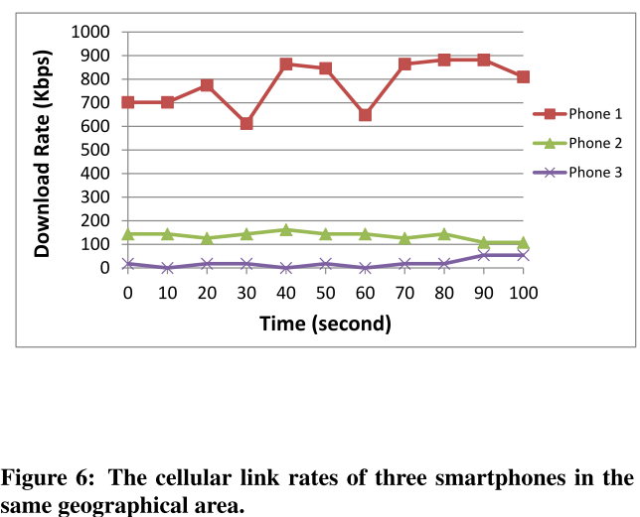
MicroDownload

Slide 27
MicroNC-P2
Compare to
BitTorrent-based distributor (BitTorrent-Pull)
R2-based distributor (R2-Push)
Consider
Clique and star topologies
using UDP packets locally

Slide 28
BitTorrent-Pull&R2-Rush
BitTorrent-Pull
Three main types of messages
Bitfield and have
Request
Piece
R2-Push
Two main types of messages
Data
brake

Slide 29
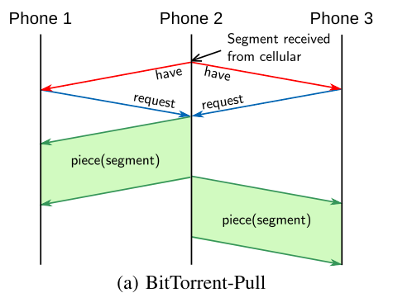
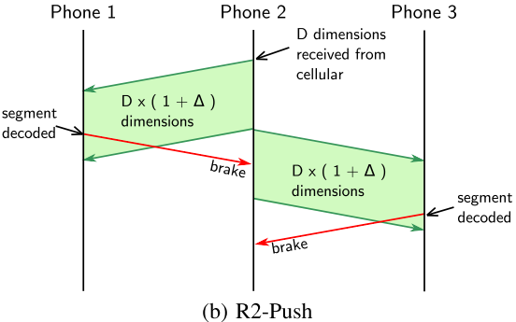
BitTorrent-Pull&R2-Rush

Slide 30
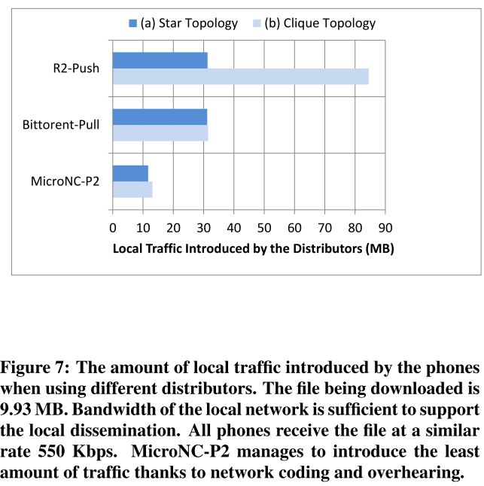
Evaluation of MicroNC-P2

Slide 31
Evaluation of MicroCast
7 phones
4 has 3G
Locally UDP
Support up to 20 Mbps UDP traffic
Star topology
Use pseudo-adhoc
9.93 MB file
Average of 3 experiments

Slide 32
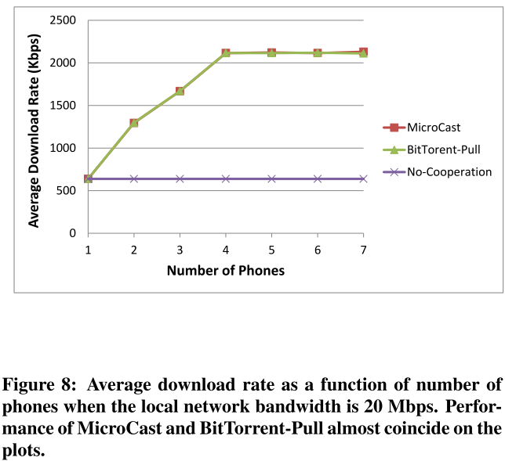
Evaluation of MicroCast

Slide 33
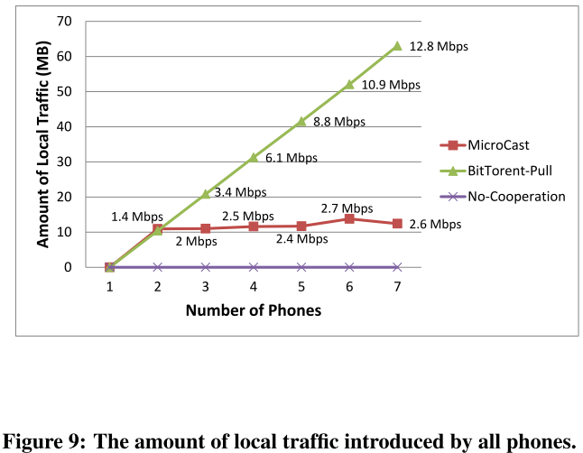
Evaluation of MicroCast

Slide 34
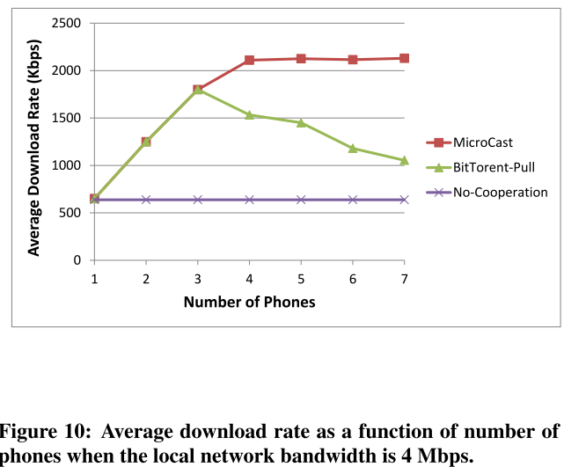
Evaluation of MicroCast

Slide 35
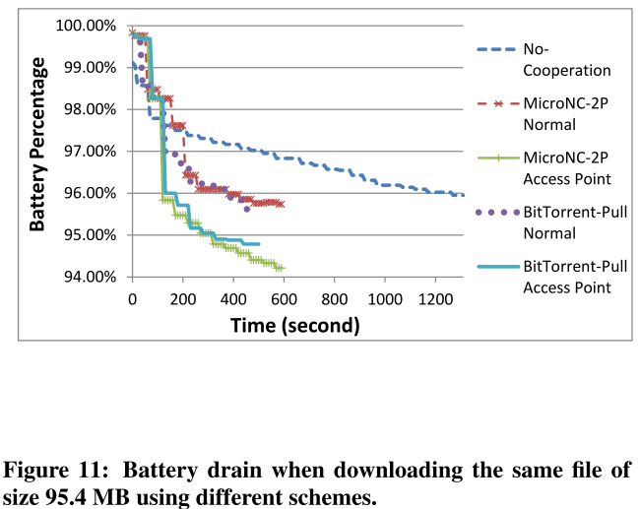
Energy consumption

Slide 36
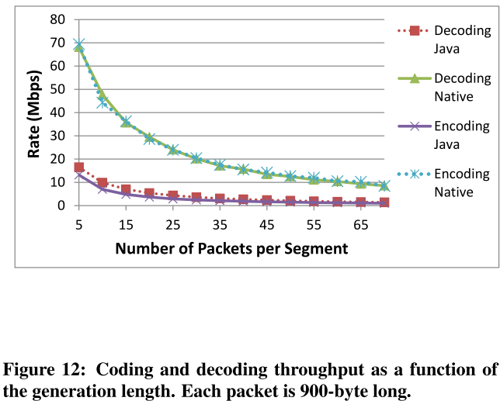
Evaluation of NC Implementations

Slide 37
Outline
Introduction
Related Work
MicroCast Architecture
MicroCast Algorithm
Implementation in Details
Evaluation
Discussion
Conclusion
Comment

Slide 38
Discussion
Limitations and Extensions
Highly modular
Bluetooth vs WiFi for local sharing
Pros and cons
Need not to root the phone
Support single and mulit-hop
But not support broadcast
WiFi vs cellular for download from server
No longer independent as they both use WiFi
MicroDownload can be improved
Small number of trusted users(under 7 users)

Slide 39
Outline
Introduction
Related Work
MicroCast Architecture
MicroCast Algorithm
Implementation in Details
Evaluation
Discussion
Conclusion
Comment

Slide 40
Conclusion
MicroCast enables users to watch the same video from the internet
It cooperatively uses the resources on all smartphone of the group
Three mainly components
Results demonstrate significant performance without battery penalty

Slide 41
Outline
Introduction
Related Work
MicroCast Architecture
MicroCast Algorithm
Implementation in Details
Evaluation
Discussion
Conclusion
Comment

Slide 42
Comment
Simple but good idea
Can try WIFI direct
Lack of some evaluation pictures

Slide 43
Q&A
Thanks for listening

